Slide 1
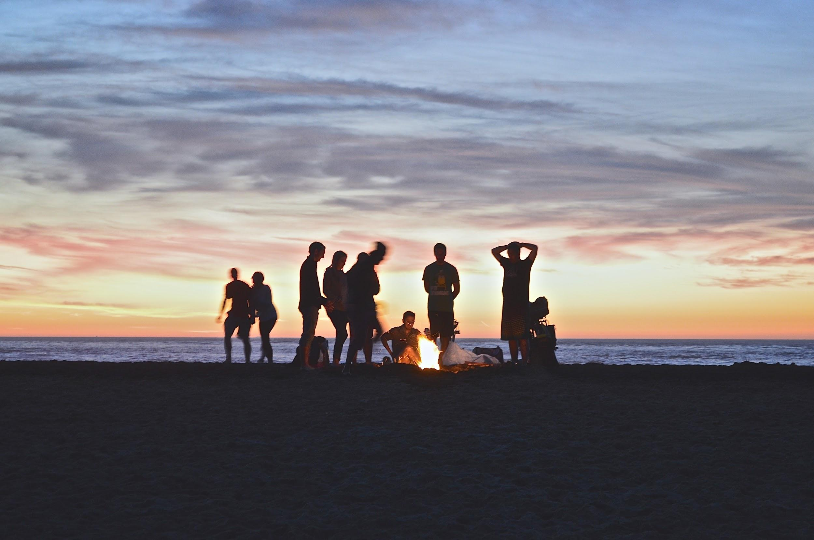
Seasoned Employee
College Senior
Gap Year Students
Parents
Grad
Student
New in Town
College
Freshman
New Employee
It's hard to branch out of our social circles.
Notes:
Michelle
I know that I'm surrounded by some of the most brilliant people in the world- and I have no mechanism for meeting them. A quarter into college, I find the people I'm closest to are the people in my dorm and in the clubs I'm in.

Slide 2

Munch helps users branch out of their social circles by matching people to share a meal
Notes:
Michelle
describe munch
Munch focuses on bringing together people within the same community. When it comes to platonic relationships, people are much more willing to meet people if they know they have a lot in common. Our focus on matching people by commonalities is what differentiates us from our competitors

Slide 3
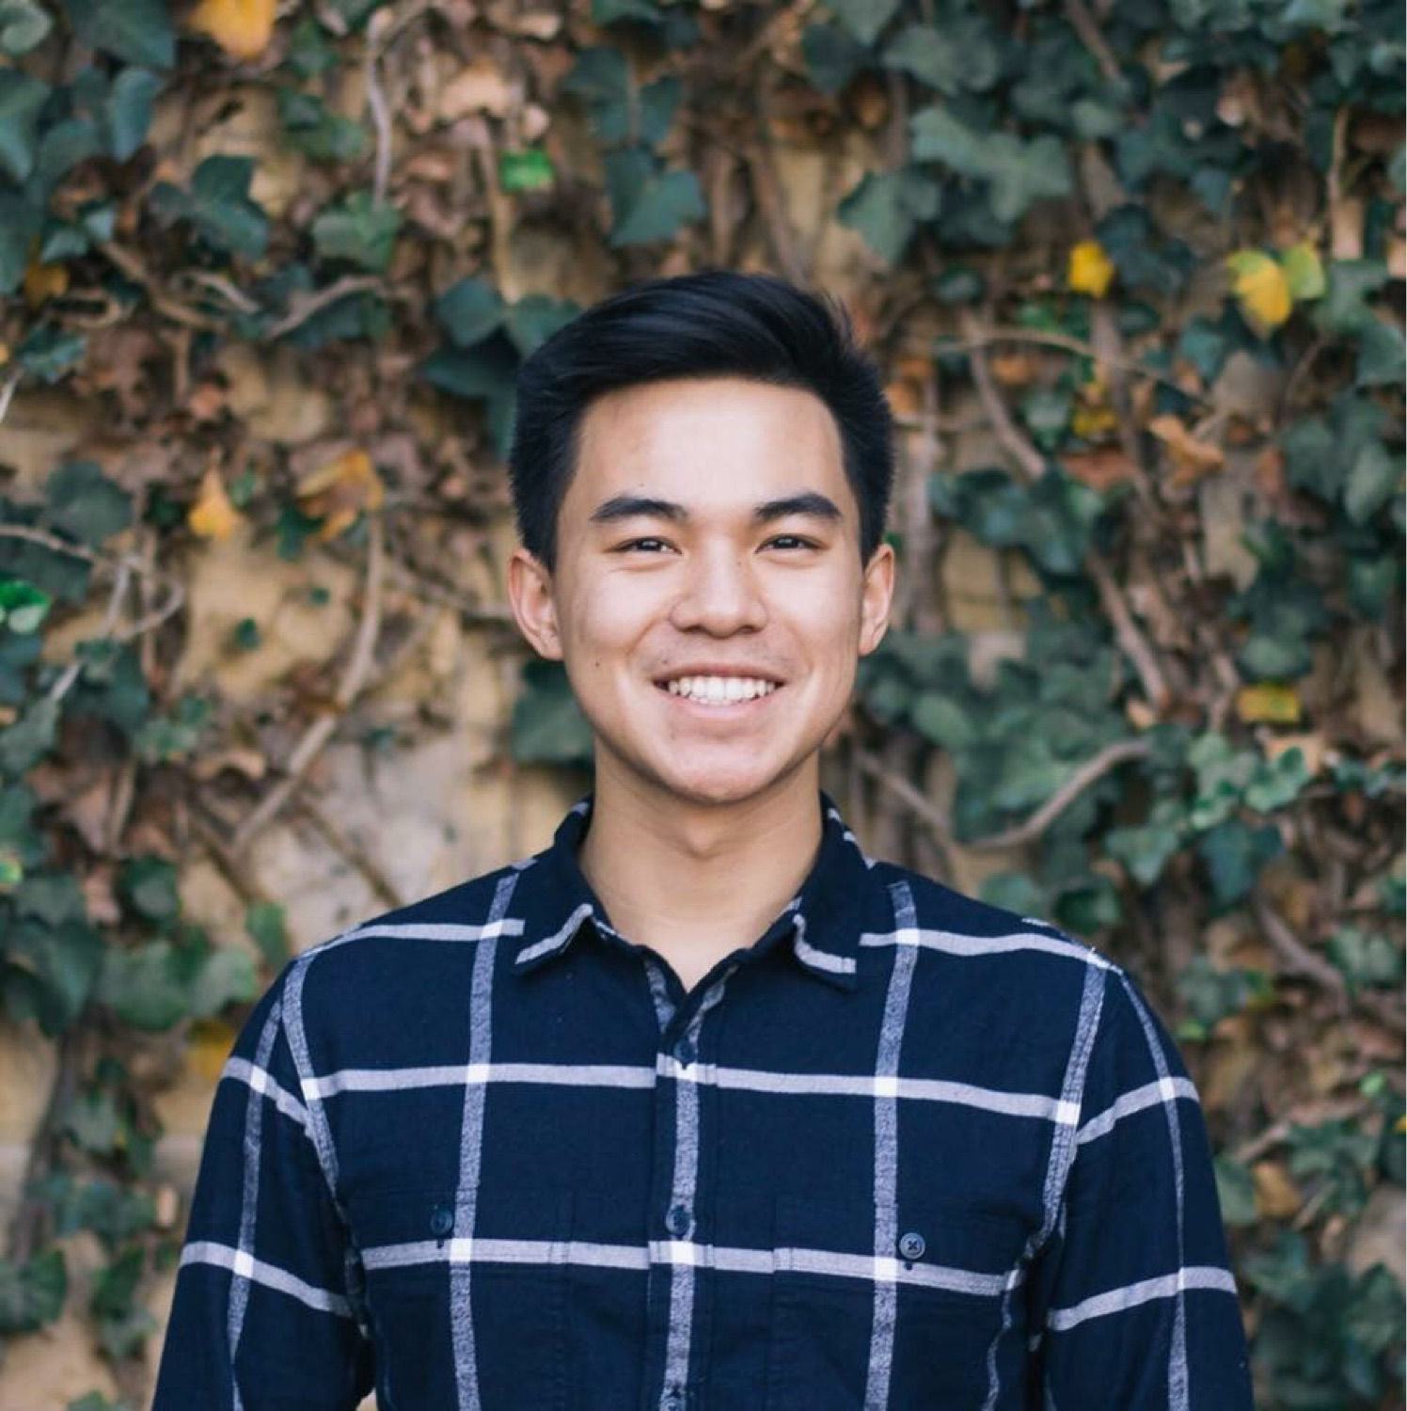
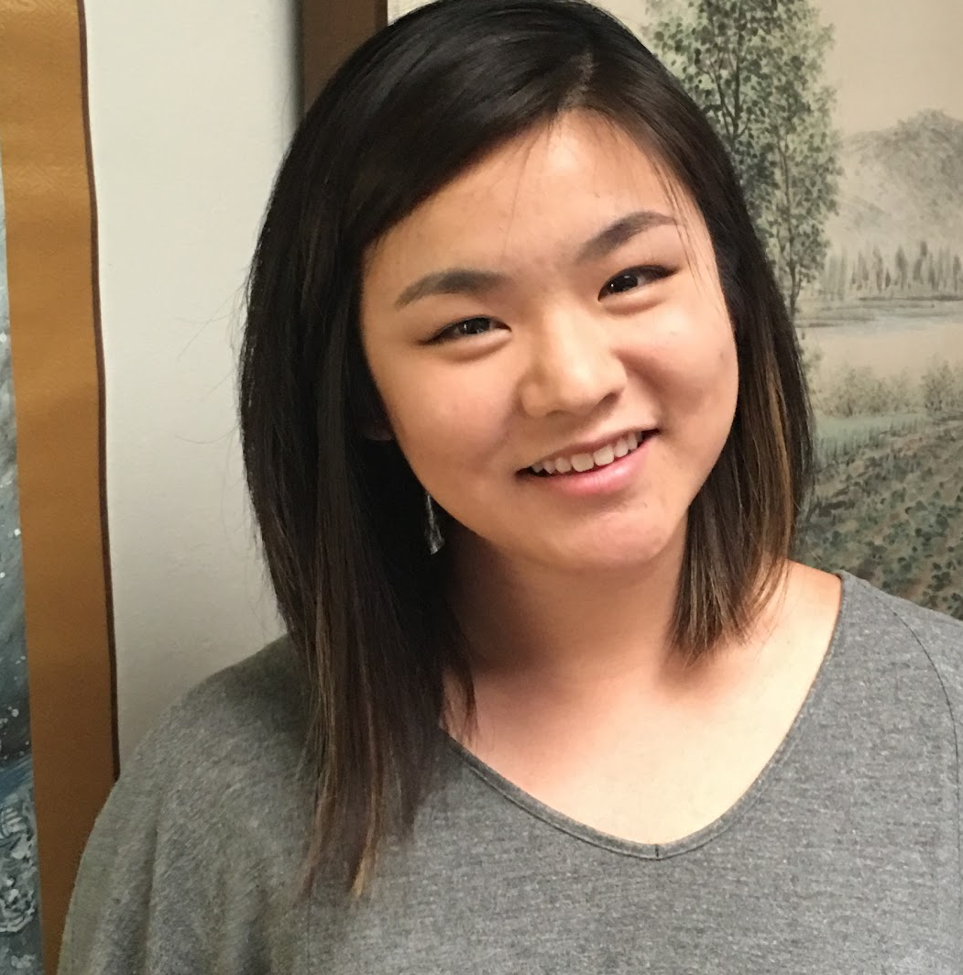
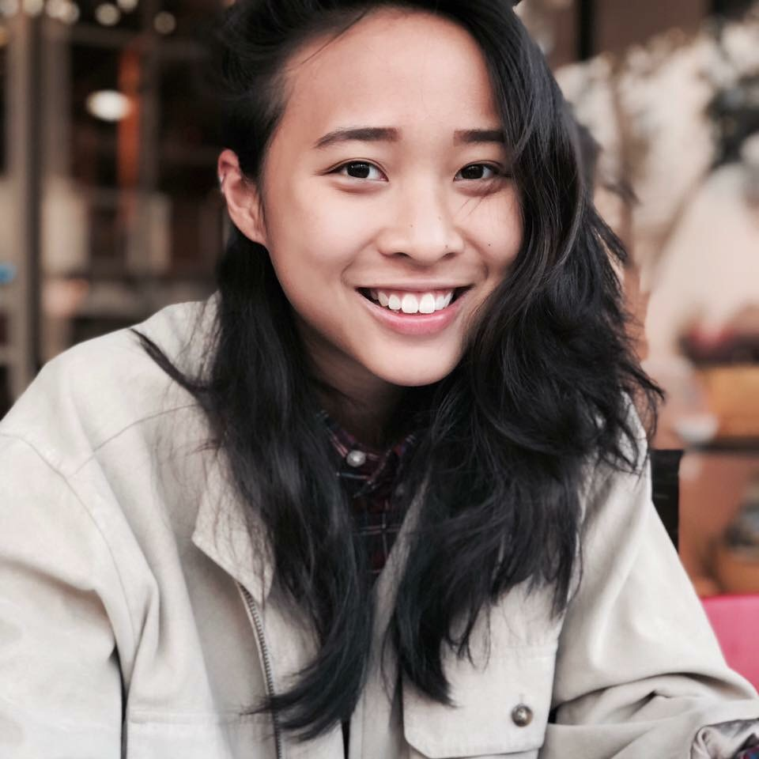
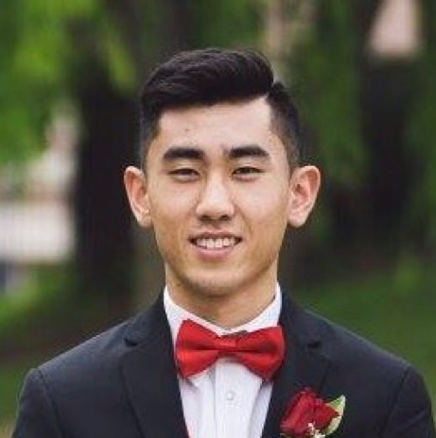
Mobile & Front-end
Development
Business Relations
Heejung
Brian
Technical
Vincent
Marketing
Michelle
Notes:
Michelle
This is the team bringing Munch to you. We’ve been working together over the last quarter and each bring our specialised skills and work experience to the table.
-You might be thinking, “why are we the perfect team to revolutionize the way we meet new people?” Well, it definitely helps that Michelle, our lead marketing director, has previous experience in just that: social media marketing. Working with companies such as Marc Jacobs and BMW, she knows how to sell this as a social media site that people will want to use over and over. Heejung, our development director, has years of experience with creating iOS apps and knows how to make a great interface that users will easily be able to navigate and enjoy using. With a strong background in computer science, Vincent understands the logistics of what Munch needs.
-Michelle- social media marketing, worked with companies with Marc Jacobs, BMW, Facebook ads and IG ads, works freelance, own client base, Search engine optimization
-Heejung- Written iOS apps, instructor for kids to learn ios app, full year internship for web development
-Vincent- Tutoring, Lifeguard,

Slide 4

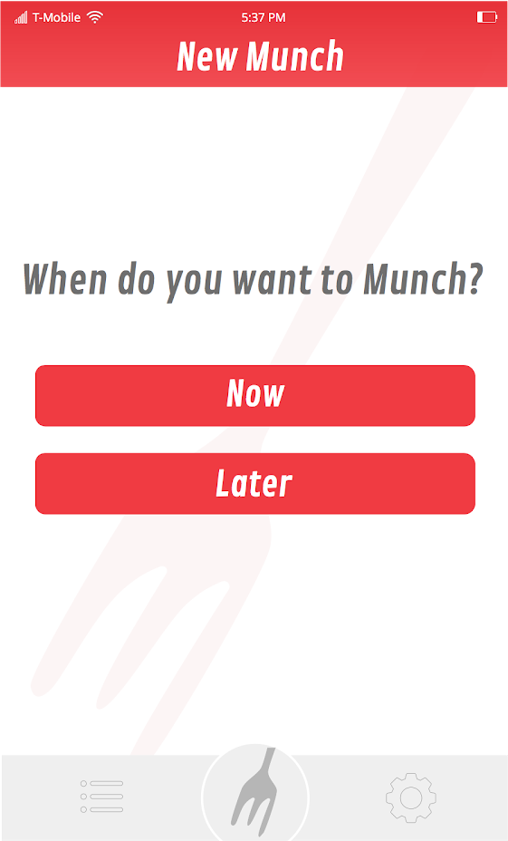
Notes:
Heejung

Slide 5
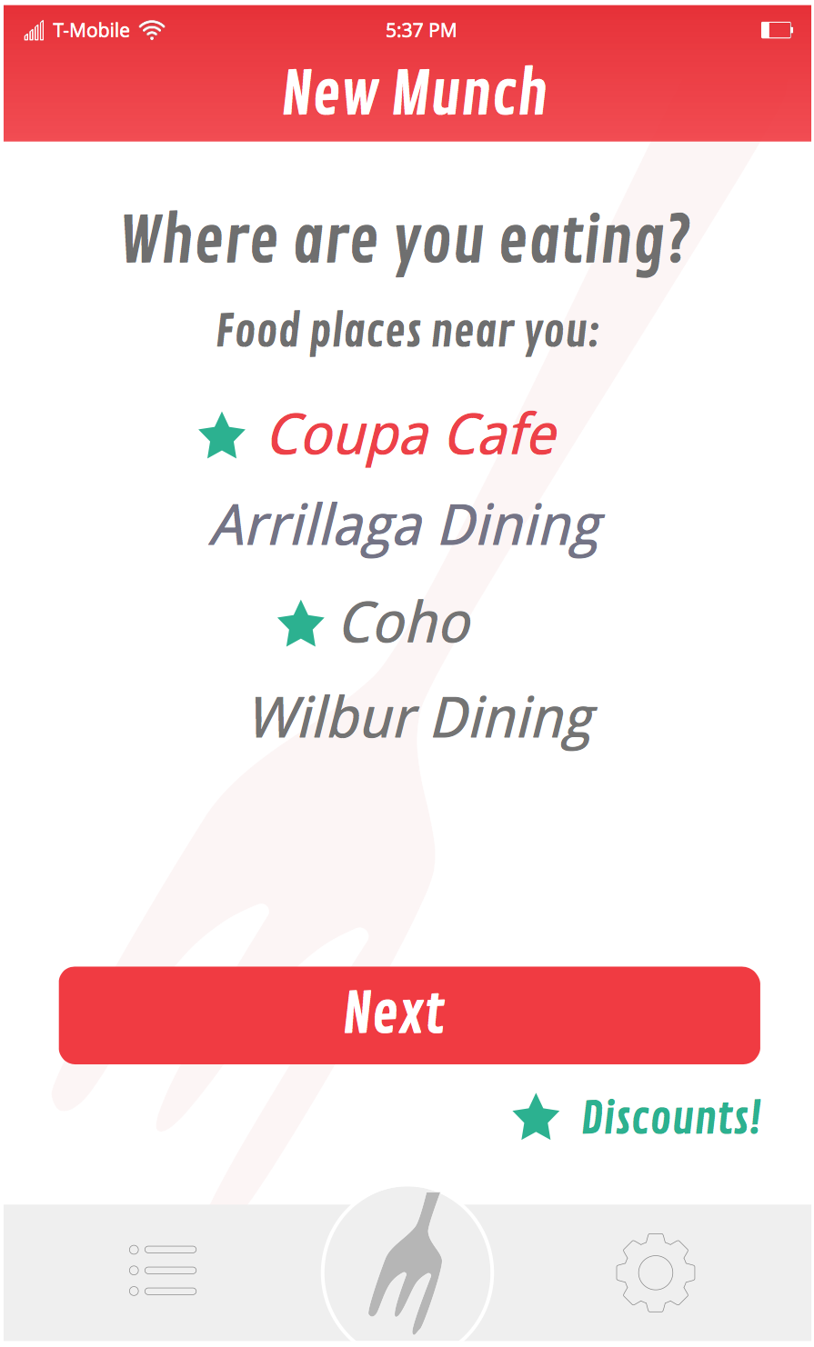
Notes:
Heejung

Slide 6
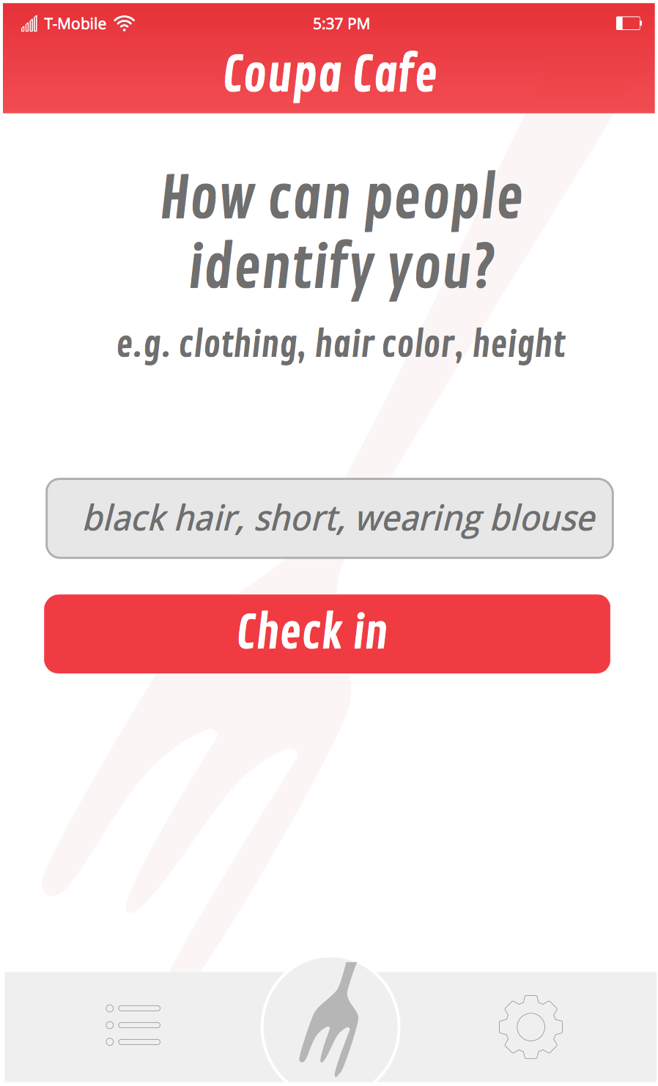
Notes:
Heejung

Slide 7
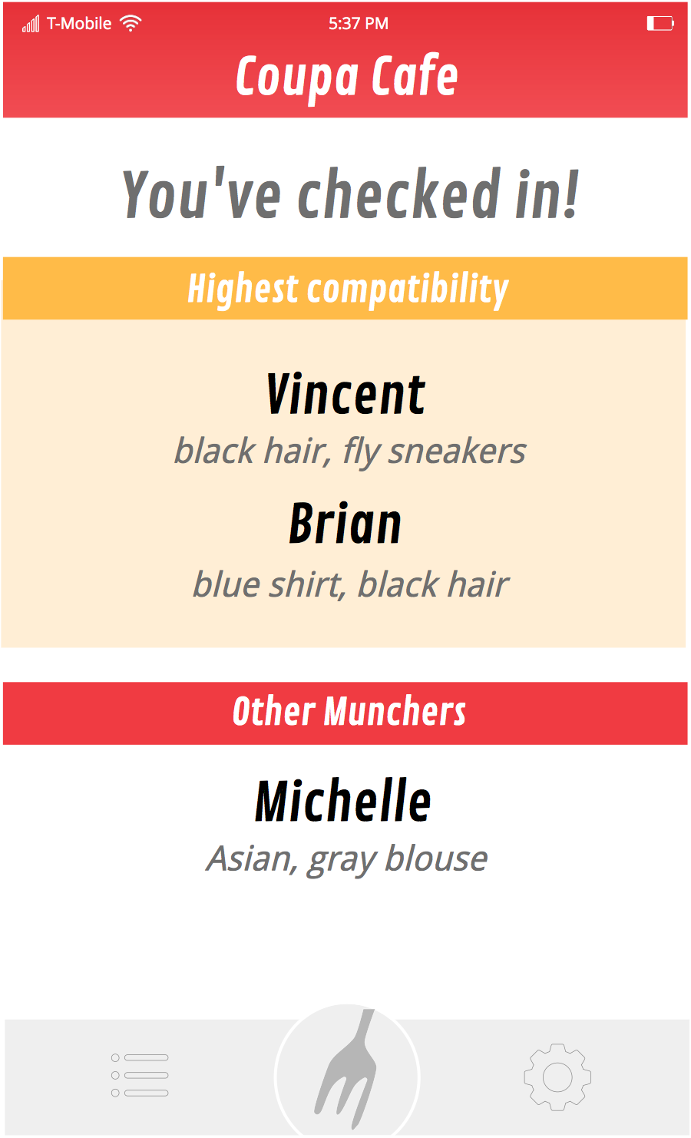
Notes:
Heejung

Slide 8




People Want to...
schedule meals with new people
decide spontaneously
build their networks
find meaningful friendships
Notes:
Heejung
What it "would" look like

Slide 9


Prototype A
Prototype B
32
40
participants
participants
Matched
Randomly
Matched by
Commonalities
Notes:
Heejung
VALIDATED THE MARKET"
We completed two prototypes to verify these claims
In both, we used emails and Google forms to create low-risk prototypes and validated our market
sent out emails to dorm mailing lists, asking strangers to try out these prototypes
In the first prototype we matched people randomly
in collecting feedback we found that theyd rather also be matched based on commonalities
in next prototype we matched based on personality, interest, hobbies– things that people may have in common and it made a difference

Slide 10
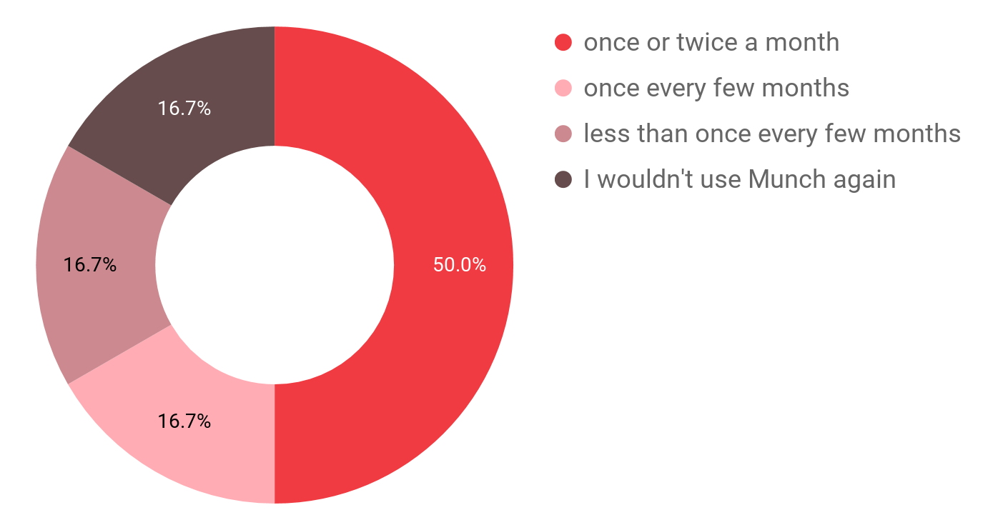
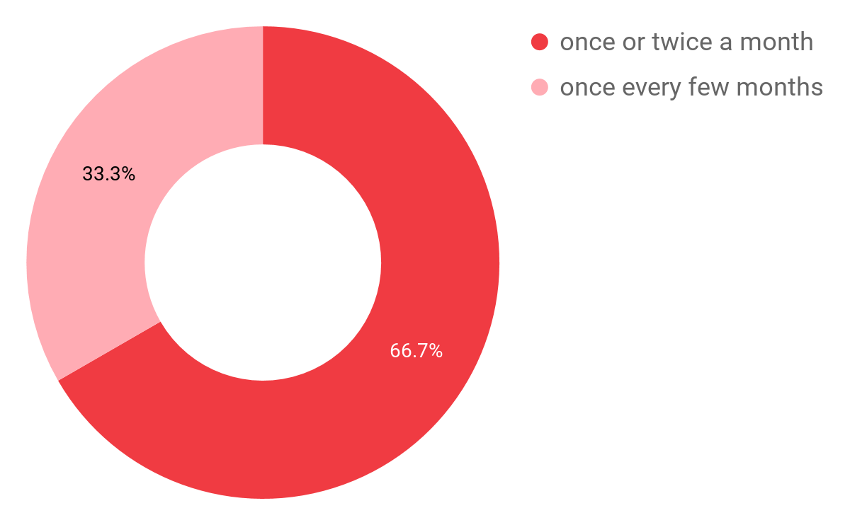
How often would you use Munch?
Matched
Randomly
Matched by
Commonalities
Notes:
Heejung
After each prototype was over, we asked users, how often would u use munch in the future
people matched randomly - only 50% said they'd use it at least once a month and 16% even said they wouldnt use it at all
people matched by commonalities - ⅔ said theyd use it once a month, and as u can see we did much better in general

Slide 11
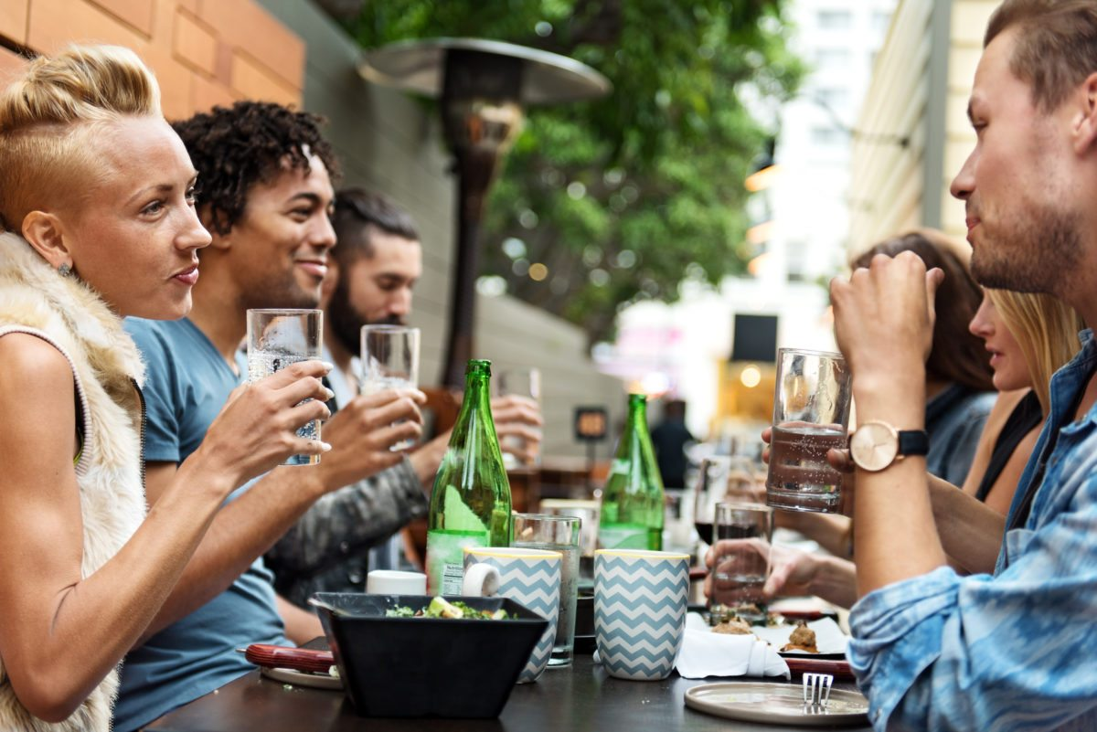
“
"What made this a good experience was the people. We were all compatible and got along. There was a good vibe."
"Will you working on Munch for the rest of the year?"
"I absolutely LOVED MUNCH...one of the people in my group told me about a research group that I’m now a part of, and I’m so stoked."
Notes:
Heejung
here are some testimonials from our users that show the range of people who find munch to be really useful
works for everyone, extroverts and introverts alike
one user even asked me if we'd continue working on this because she couldn't wait to use munch again

Slide 12




No Flakes
Spontaneity
Compatibility
Discounts
Meeting New People
Building Quality Friendships
Notes:
Michelle
Munch is able to increase the time users spend on the app by the special check-in function. This introduces an on-going conversation with users of the app. Instant connection that requires no planning and is easy to use. We completely remove any chances of “flaking” by making the connection instant.
While there are already many other social networking apps, such as Tinder and Facebook, Munch is significantly better at introducing users to new people as well as building quality friendships from these interactions.
Unlike other services, we match based on commonalities, like where you work or where you go to school.
For example, as a freshman at Stanford, I would rather meet another fellow Stanford freshman than a rando from downtown Palo Alto.
On top of this, Munch provides discounts for its users at certain restaurants to further incentivize people to use our product over others.
we match based on commonalities -- like where you work, or where you go to school
foster quality friendships
talk a lot about how our discounts incentivise people to use our product over others
Good for people who don't have enough time.

Slide 13

Monetization
Restaurant Advertisement
Notes:
Michelle
restaurants pay us to send them our users as customers
subscription model - users pay to get bonus features like discounts
Model name****

Slide 14
Go-To-Market Strategy

Slide 15
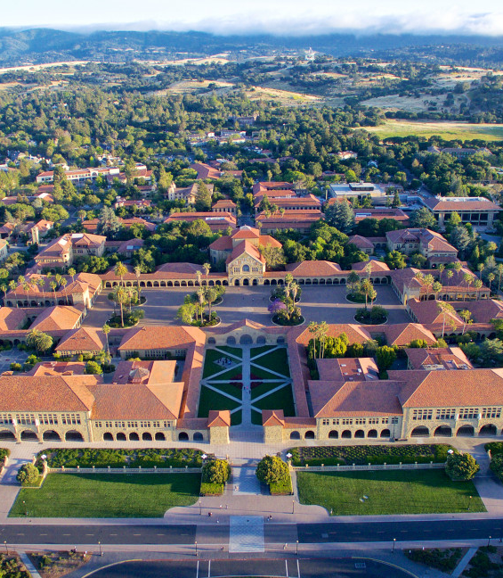
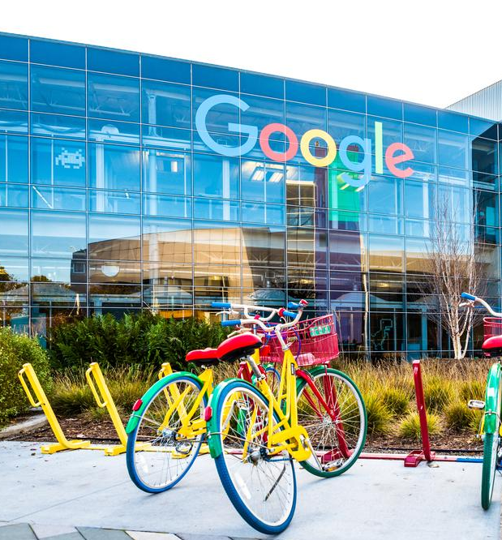

4,600
University campuses
in the U.S. alone...
… Munch also works on corporate campuses
Notes:
Breaking into the market:
Viral videos on instagram and facebook
Sticker distribution on college campuses
Advertising by linking up with restaurant owners and asking them to put up stickers on their restaurants
Flyering/ emails

Slide 16



Visual Advertisement
Influencers

Slide 17


Chatbot
Prototype
Mobile App
Notes:
Michelle
In the future, we see implementing an app will push Munch to be even more user-friendly. Previously, a chatbot allowed users to be reminded of when and where their Munch was in regular time intervals. However, after creating an app, users will be able to not only be reminded of their Munch, but will also get instant access to directions of where their Munch is and real-time data as to whether their Munch group is already there or not.

Slide 18
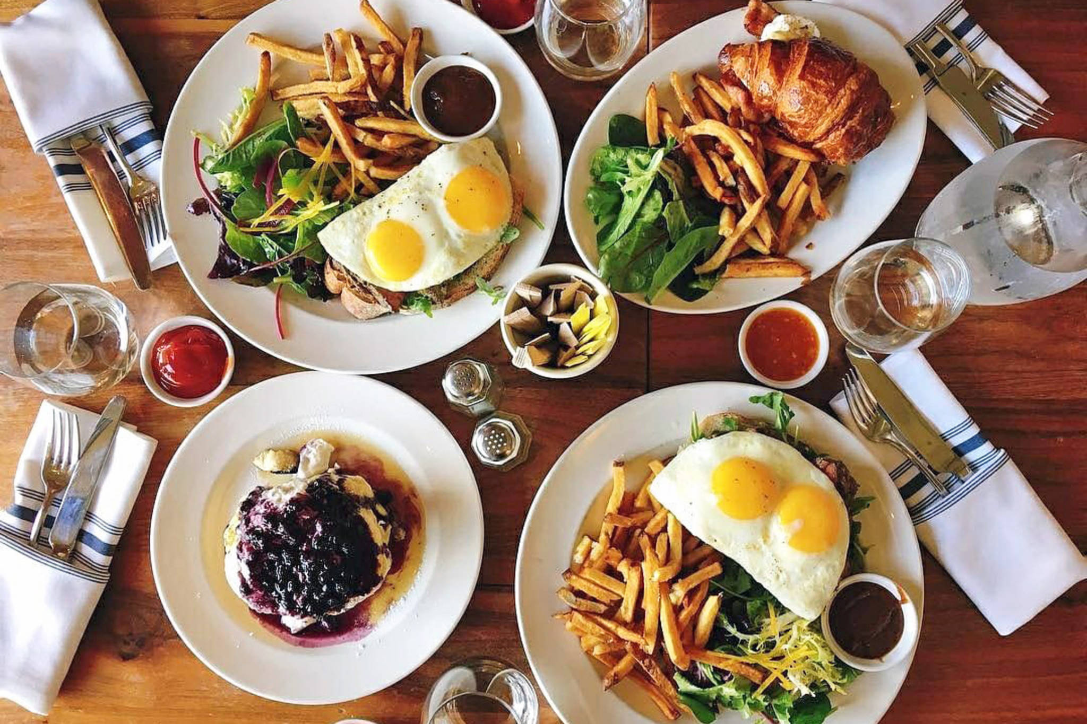



Connection
Food
Platonic Friendship
Notes:
michelle
So there you have munch. Munch helps users branch out of their social circles by matching people to share a meal. We're promoting connections between people and helping people form friendships, over their love of food.

Slide 19


